Slide 1
Enterprise Content Management

Slide 2
Outline
WCM Platform Improvements
ECM and Enterprise Metadata
Advanced Routing and Document Sets
In Place Records Management

Slide 3
WCM Platform Improvements

Slide 4
WCM Content Authoring Improvements
Authoring Experience
Benefits from the UX improvements
One-click page authoring
Automatic check for unpublished items
HTML Editor
Cross browser, tight integration with Ribbon for extensibility
Web Asset Editor
Easy to find, sort and view assets
No dialog refresh (only content area)
Integrates with Asset Library (ECM)
Embedded Video
Stored in SQL / external BLOB
Skinable Silverlight plugin
Notes:
Authoring Experience:
UX improvements
Minimal page postbacks… only when necessary
Ribbon
One-click page authoring

Slide 5
WCM Platform Improvements
Large Pages Libraries
MOSS 2007 did not support folders to facilitate large Pages libraries (MSKB #948614)
Folders in Pages libraries now supported
Check for unpublished items
Unpublished content called out when publishing a page
Content Organizer
Site owners configure rules for new content
Content authors create content, let the organizer move it to the desired location
Automatically create subfolders in Page libraries for lots of content (ie: Press Releases 2008/2009)
Notes:
Large Page Libraries – talk to the content organizer
Check for unpublished items
MOSS 2007 required content authors to perform an extra step to determine if referenced content on the page was published
Content Organizer

Slide 6
Content Query Web Part
Context filters introduced
Filter query results based on query string or current page content values
MOSS 2007 only allowed static filters OOTB
SharePoint Server 2010 adds capability for page authors / designers can select content fields to display via customization IU
In MOSS 2007, developers had to manually specify these fields in the CQWP’s CommonViewFields property & in the XSLT
Notes:
Content filters
CQWP now supports filtering content based on values in content fields on the current page or from values on the query string
Content fields
SharePoint 2007 required developers to manually enter custom content fields to be passed to the CQWP XSLT using the CommonViewFields node
SharePoint 2010 now lets users pick them in the UI

Slide 7
WCM Content Deployment
Primary MOSS 2007 Issue: export
SharePoint Server 2010 content deployment still has same export process, but alternate method pushed:
SQL Server Database Snapshots
Snapshots available in SQL 2005 & 2008 Enterprise Edition
Snapshot used on the source server to avoid concurrent authoring issues; snapshot not sent to destination for restore purposes
Notes:
Snapshots don’t ‘fix’ content deployment issues, they address a major pain point by creating a point-in-time snapshot that can’t be edited which is then used as the export source of content

Slide 8
Web Analytics
Web Analytics Service Application
Web Analytics Reports
3 report categories: Traffic, Search, Inventory
3 report levels: Site, Site Collection, Web Application
2 report types: trended, or ranked (Top X)
Web Analytics Workflows
Alert Metric Changes
Schedule Reports
What’s Popular Web Part
Support Popular Content, Search Queries, and Search Results
Notes:
Web analytics replaces the 2007 Usage Analysis
Provides basic reporting on a SharePoint site
Users can setup scheduled reports
OOTB Web Parts help expose popular content

Slide 9
ECM & Managed Metadata

Slide 10
Enterprise Content Management
Significant investments in both platform & features for ECM in SharePoint Server 2010
Enterprise content types
Define once for the enterprise, use in multiple site collections in the same or different farms
Metadata everywhere
Managed Metadata
Featurization of MOSS 2007 RM specific capabilities
Advanced Routing
Document Sets
Unique Document ID Service
Notes:
Enterprise Content Types (not to be confused with the BCS External Content Types) are defined in one site collection and can be published across multiple site collections and across farms.
Significant investments around metadata
Managed Metadata = support for establishing taxonomies & folksonomies
Featurization of SharePoint 2007 records management capabilities
Document stets – multiple files make up a single work product (more later)
Unique Document ID Service – a document has a unique URL for a site collection, no matter where it is moved to

Slide 11
Managed Metadata Service
Managed Metadata Service Application
Term Store
Content type syndication
SharePoint Metadata Manager
Term & keyword field support in Office 2010 clients
Import of Managed Metadata data from another taxonomy store
Term & keyword integration in Office 2010 clients via Backstage
New managed metadata field type bound to a term set
Notes:
Managed Metadata service app
Admins define term store (taxonomy)
Admins define the location of the ECT site collection hub
Metadata Manager = utility used to manage the term store
Admins can import a CSV file that contains a taxonomy into a new term store
SharePoint 2010 now has a Managed Metadata field type that’s bound to a term set and used in tagging of List Items

Slide 12
Enterprise Content Types
Content types were scoped at the site-level (SPWeb) in WSS 3.0
Site-level content types still exist in MSF
New MM Service Application allows syndication of “enterprise” content types across sites, site collections, Web apps & farms
Define one site collection as the content type hub
Enterprise content types are read only in sites
Sites can have enterprise and local content types in sites
Local content types can inherit from enterprise content types
Notes:
Content types that are syndicated can’t be changed in the child sites, but site owners can create new content types that extend them to implement changes

Slide 13
Metadata Everywhere
Huge investments in metadata across the platform
Metadata based navigation
Easier for users as content is more discoverable
Content stewards help in creating indices on metadata fields for enhanced nav. performance
Users can now filter search results using metadata of result set
Location based metadata
Content stewards create helpers for libraries & content types
Notes:
Metadata navigation – ability to browse a document library filled with tagged content according to the taxonomy, ignoring the folder organization
When search results are shown, metadata (tags) are used as one of the search result refiners

Slide 14
Term Store, Term Sets & Terms
Service Application (Term Store) » Groups » Term Sets » Terms
Locations » Cities » Redmond
Administrators & users create term stores & terms
Flat list or hierarchical list
Can have custom properties associated with each term
Disambiguating, reusing, merging & deprecating terms
Term store facilitates the management & retrieval of metadata & relationships
Terms can belong to one or more term sets
Translations & synonyms
Notes:
Metadata managers create the taxonomy which consists of a hierarchy of tags
Tags can have translations and synonyms (United States = US or USA)
There are many controls you can implement on tags… from reuse to merge to deprecating & disambiguating
Each tag has a property bag of custom properties that is available via the OM

Slide 15
Keywords & Tags
Keywords
Free text with no enumerable sources
Like tags but without enterprise characteristics (synonyms, translations, hierarchical, etc)
Can be promoted to a term & vice versa
Tags
Can be terms or keywords
Shell Tags:
Kept in sync with the item’s managed keyword field
Saved in the item’s managed keyword field
Social Tags:
Allows users to create and apply keywords to items
Stored in social store, not with the item itself
Notes:
Keywords
No structured organization… users can enter at will
Admins can promote a keyword into the taxonomy
Tags
These are things that are directly associated with a file

Slide 16
Metadata Manager
Provides rich interface for full management of term sets and terms
Import of term sets and terms
Manage custom properties (via API)
Translations & synonyms
Manage term set / term languages
Submission policy (open / closed)
Open means users can submit terms to the term store (when adding / editing items)
Regardless of the policy, users can always submit keywords
Notes:
The metadata manager offers full control over the management of the terms within term sets
It allows importing from a structured CSV fiel
The term set policy can be set to:
Open – anyone can contribute to it
Closed – only admins can contribute to it

Slide 17
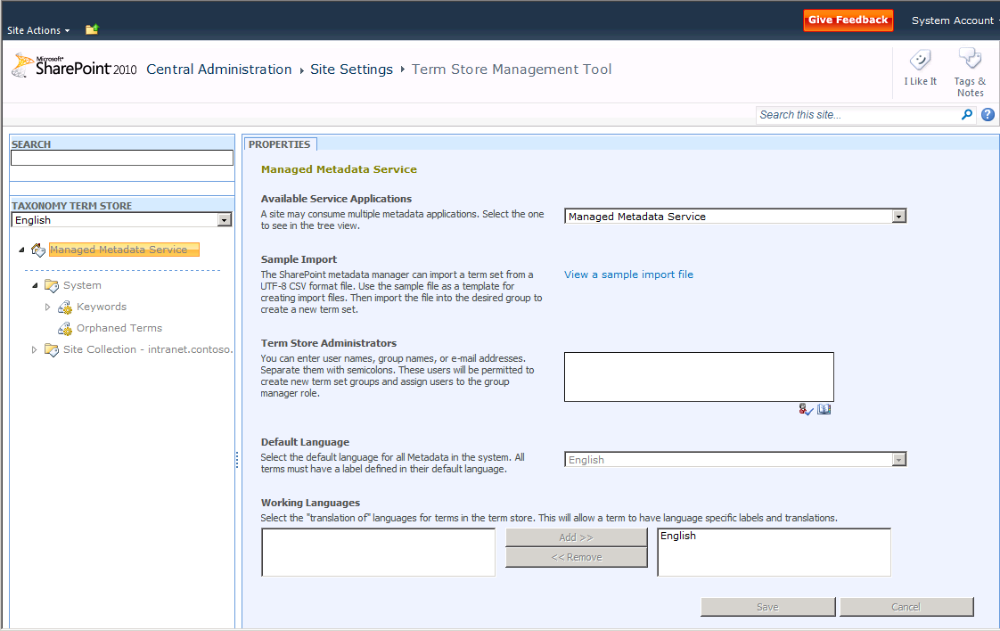
Metadata Manager

Slide 18
Enterprise Metadata
demo
Notes:
<PRECURSOR> need two WebApps, each with SPSites in them, or two SPSites in one WebApp
DEMO
Show MMSA management (add admin as admin to both service app and term manager store)
Content type syndication
Setup at the MMSA level
Creating CT’s at the SPSite/SPWeb level & configure for publishing
Check the other SPSite’s to show their config & reporting details

Slide 19
Advanced Routing and Document Sets

Slide 20
Featureization of MOSS 2007 ECM
Many things in MOSS 2007 ECM were tied to the Report Center site template
SharePoint Server 2010 emphasis on “Feature-izing” these things for use across platform
Hold actions no longer tied to Record Center
MOSS 2007 Record Router = SharePoint 2010 Document Router
Custom Action “Delete record & submission info” now available in any site with Routing Workflow Feature enabled
Notes:
Record Center site template is no longer THE source for all ECM stuff… most stuff broken into WSS Features for use anywhere
New Routing Feature
In place records management:
RM capabilities supported at item level; not required to create a whole RM solution
Allow custom records keeping solutions
Admins can define what a record is and who can create them

Slide 21
Advanced Routing
Users typically need a good understanding of the site / library structure to know where to save documents
Advanced routing - users upload to sites
Routing rules will determine where the document is saved
Routing rules defined by site administrators
Adds capability for documents to be sent to Record Center automatically on a schedule

Slide 22
Document Sets
MOSS 2007 treats documents as atomic & not linked to other documents
SharePoint 2010 introduces document sets, or a collection of documents, spreadsheets, presentations, etc that make up a single work product
Metadata exists on individual items and the set as a whole
Notes:
Document sets pull multiple items together to create a single work product
Each item is seen as an individual item, but the whole set can be versioned, participate in a workflow or downloaded

Slide 23
Document Sets
Each document set has:
List of available content types allowed within it
Default content automatically added to the set
Can create shared columns (defined in document set’s content type) that are pushed down across all content in set
Welcome page acts as the homepage for doc sets
Customizable Web Part Page displaying the document set’s properties
Notes:
Document set is a content type that contains other content types
Doc set content type is represented as a folder
Welcome page is a Web Part page that can be customized
Content in shared columns is pushed down to each item in the set

Slide 24
Document Sets – Templates, Versioning
Document Templates:
Admins can provide users document templates for creating new items for the work product
Templates created with Visual Studio
Document Set Versioning:
Set owners can capture the state of the set at different points in the lifecycle
Ability to see point-in-time history of the set
Set owners can restore to a previous version of the set
Notes:
Point here is to emphasize that the doc set is seen as a single atomic unit that is comprised of many child components.

Slide 25
Document Sets - Workflow
Special OOTB activities for working with document sets provided for SharePoint Designer authored workflows
OOTB workflow provided for working with document sets
Notes:
Point here is that doc sets can be wrapped up in their own workflow

Slide 26
Document Sets
demo
Notes:
Demonstrate creating two new content types
Add these two new content types to a new document set
Add doc set to a doc library and demonstrate interactions

Slide 27
In Place Records Management

Slide 28
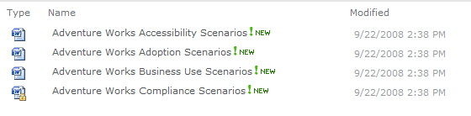
In Place Records Management
MOSS 2007 records management functionality no longer tied to Records Center site template
Site Collection Feature: In Place Records Management
Define who can & can’t declare records
Notes:
Records management capabilities are no longer required for a specific site template… they have been refactored to Features
Records can now be created side by side with other documents in the same library

Slide 29
Unique Document ID Service
New site collection Feature: Document ID Service
Adds unique ID for all documents throughout the site collection
Documents can be retrieved regardless of the current of future location based on their unique ID
Notes:
New to SharePoint 2010 is the ability to assign a document a unique ID
Unique to the site collection
This ID when used in conjunction with a specific URL (by sticking the ID on the query string) will take people to the document regardless if it is moved within the same document library or across libraries within a site collection

Slide 30
Summary
WCM Platform Improvements
ECM and Enterprise Metadata
Advanced Routing and Document Sets
In Place Records Management

